Slide 1



President Trump Twitter Analysis & Election Simulation
Group 2: Pied Piper
Alex Bzdel
Zach Galante
Robert Mitchell

Slide 2
Presentation Outline
Hypothesis
Data Description
Part 1 - Approval rating analysis & results
Part 2 - Presidential election simulation & conclusion

Slide 3
Data Description
Two sets of data
Set 1 - scraped via GenOldTweets
Data from January to present
Does not provide user data
Used for approval rating analysis
Set 2 - scraped via twitter API
All recent data
Provides more in depth user data
Used for simulation
Third party data
Trump approval rating csv
Will be used in conjunction with set 1

Slide 4
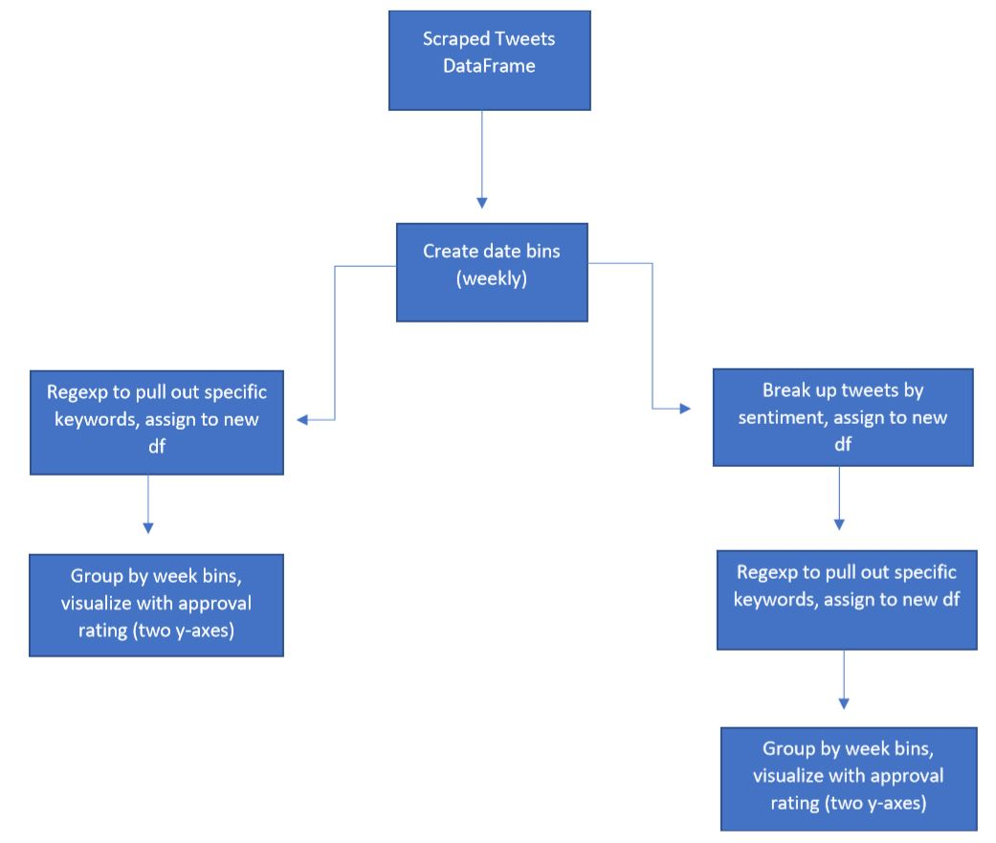
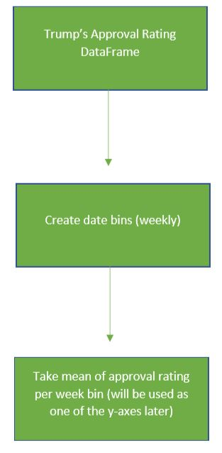
2020 President Sentiment Analysis

Slide 5
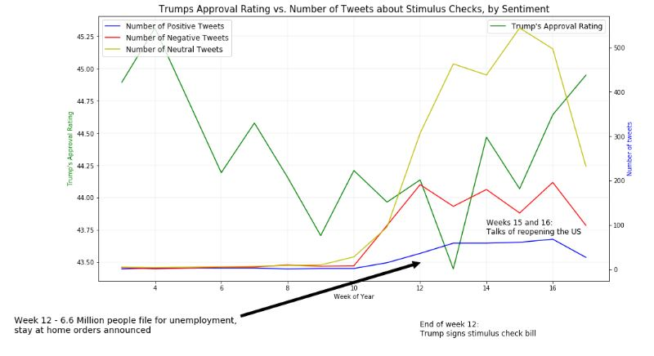
Results - Part 1

Slide 6
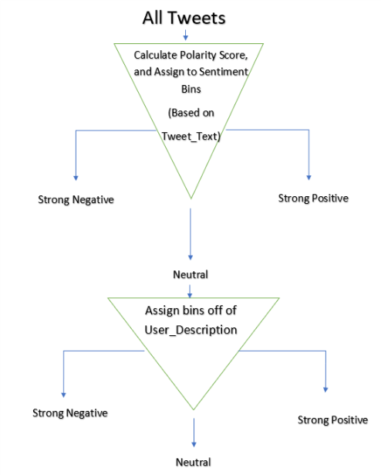
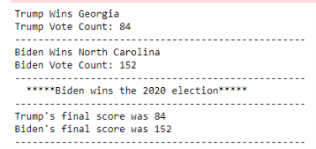
2020 Presidential Simulation

Slide 7
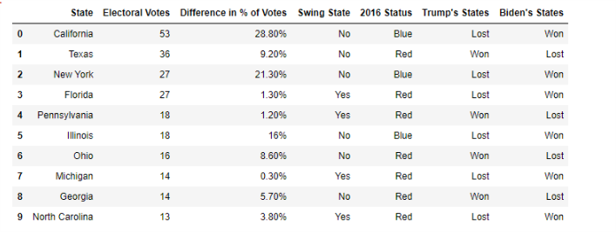
Results / Conclusions

Slide 8
Thank you!
Group 2: Pied Piper
Alex Bzdel
Zach Galante
Robert Mitchell

